Slide 1
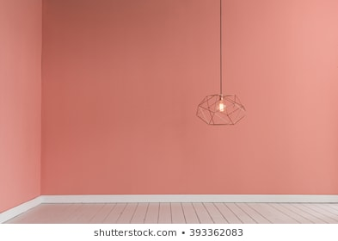

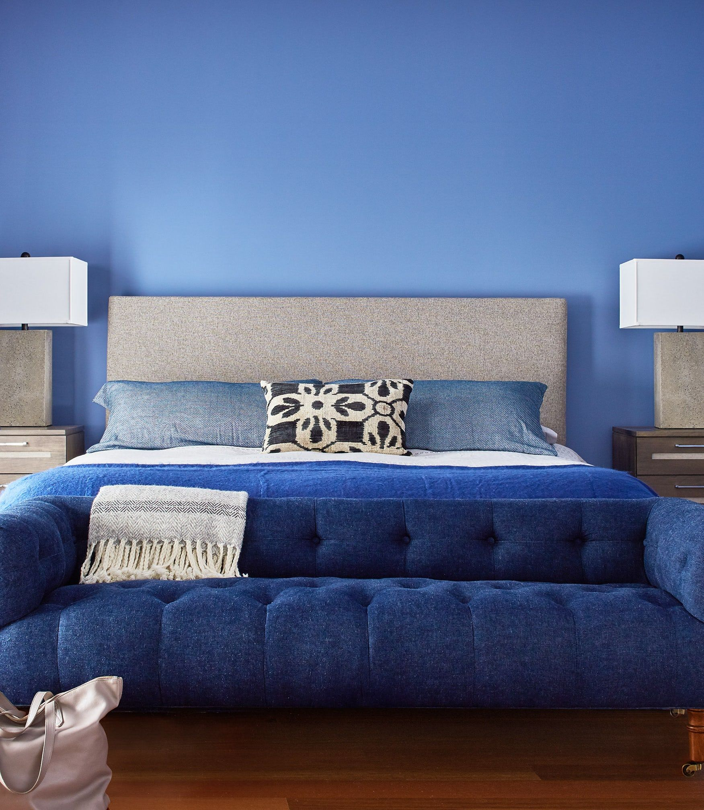
Living Room [ room1 ]
ColorDecorator
2000
pink
2000
CurtainDecorator
Bed Room [ room2 ]
2000
red
ColorDecorator
3000
3000
Living Room is decorated by ColorDecorator and CurtainDecorator
Bed Room is decorated by ColorDecorator only.
blue

